Slide 1
BUSINESS OWNERSHIPS AND LEADERSHIP
CHAPTER Introduction

Slide 2
What Is a “Small” Business?
Small Business Defined: Independently owned and managed business that does not dominate its market (e.g. locally owned and operated restaurants / hair solons Vs giant corporations like Sony or Kodak)

Slide 3
What Is a “Small” Business?
The Importance of Small Business:
  Job creation
  Innovation
  Importance to big business: most of the products made by big businesses are sold to consumers by small ones.

Slide 4
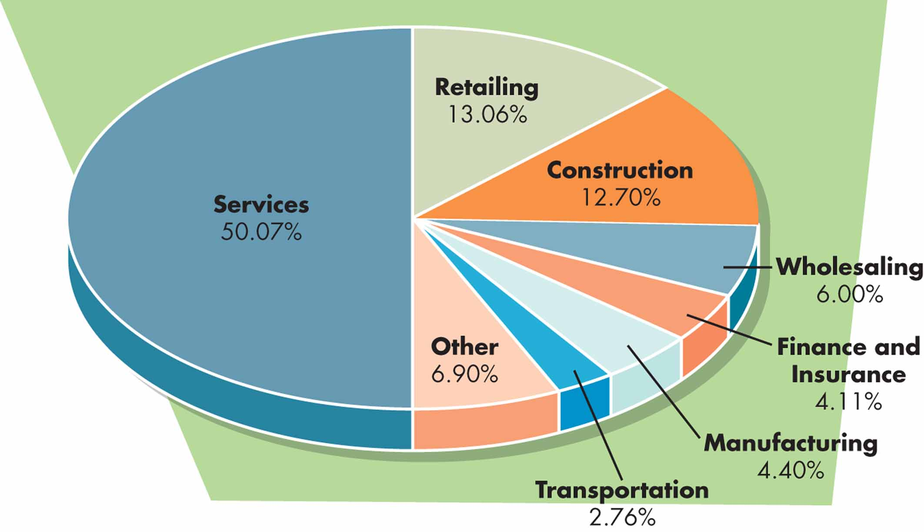
FIGURE 3.2: Small Business by Industry
© 2009 Pearson Education, Inc.

Slide 5
Franchising
A franchise permits the franchisee (buyer) to sell the product of the franchiser (seller or parent company).
Franchisees benefit from the parent corporation’s experience and expertise and the franchiser may supply financing, pick the store location, design the store, purchase equipment, train employees and managers, and issue policies and procedures.
Disadvantage: starting cost plus a percentage of sales.

Slide 6
Business Ownership
Forms of Legal Ownership: sole trader, partnership, or corporation / company.
Choice of Ownership Form

Slide 7
Sole Trader (owned and operated by one person)
Advantages: Freedom (report to no one), simplicity) tax and accounting obligations.
Disadvantages: personal liability for all debts incurred, financing depends on the resources of one person, managerial limitations, borrowing maney.

Slide 8
Partnerships (number of partners-owners)
Advantages: ability to grow by adding new talent and money, simple as the partnership agreement is a private document.
Disadvantages: unlimited liability; liable for all debts may occurred, difficulty in transferring ownership.

Slide 9
Corporations
Corporation: Business that is legally considered an entity separate from its owners and is liable for its own debts; owners’ liability extends to the limits of their investments.

Slide 10
Corporations
Advantages: limited liability: Investor liability is limited to personal investment in the corporation.
Continuity: continuity of corporation; shares may be sold.
Professional management
Disadvantages: start up cost; meeting the complex legal requirements.
Double Taxation: taxes are payable by both corporation and shareholders.

Slide 11
Types of Corporations/ Companies
Private: stock is held by few and is not available for sale to the public.
Public: stock is available for sale to the public.
Partnership
Limited liability
Multinational: Form of corporation spanning national boundaries.
© 2009 Pearson Education, Inc.

Slide 12
Managing a Corporation
Corporate Governance: roles of shareholders, directors, and other managers in corporate decision making.
- Stockholder / shareholder: Owner of shares of stock in a corporation.
- Board of Directors: Governing body that reports to its shareholders.
- Chief Executive Officer (CEO): Top manager hired by the Board of Directors to run a corporation

Slide 13
Special Issues in Corporate Ownership
Joint Ventures and Strategic Alliances: Two or more organizations collaborate on a project for mutual gain. Joint Venture: strategic alliance in which the collaboration involves joint ownership of the new venture (e.g. Sony-Ericson mobiles).
Employee Stock Ownership Plans: allows employees to own a significant share of the corporation.
Institutional Investors: Large investor, such as a mutual fund or a pension fund that purchases large blocks of stock.

Slide 14
Special Issues in Corporate Ownership (cont’d)
Merger: The union of two corporations, roughly of the same size, to form a new corporation .
Acquisition: The purchase of one company by another.

